Slide 1




NEXT GEN EMPLOYABILITY PROGRAM
Creating a future-ready workforce
Team Members
College Name
Student Name :M.Swetha
Student ID :au814721104056
SRM TRP Engineering college

Slide 2

CAPSTONE PROJECT SHOWCASE
Project Title
Notes Sharing Web Application using Django Framework
Abstract | Problem Statement | Project Overview | Proposed Solution | Technology Used | Modelling & Results | Conclusion

Slide 3
Abstract
This project aims to develop a Django-based web application designed for seamless sharing of educational notes between teachers and students.
The application provides a platform where teachers can upload, manage, and share course materials with their students, and students can access, view, and download these notes according to their respective courses.
The system facilitates efficient communication and knowledge dissemination within educational institutions, enhancing the learning experience for both teachers and students.
Through a user-friendly interface and robust functionality, this application fosters collaboration and academic success in the educational community.
Source :

Slide 4
Problem Statement
The current landscape of notes sharing applications lacks seamless integration across devices and platforms, hindering users' ability to access and collaborate on their notes efficiently.
Existing solutions often suffer from limited functionality and inadequate security measures, leading to potential data loss or privacy breaches.
Students face challenges in organizing and sharing their notes effectively, resulting in reduced productivity and collaboration potential.
Source :

Slide 5
Project Overview
Our notes sharing application is a comprehensive platform designed to facilitate seamless note creation, organization, and collaboration for users across various devices.
With intuitive features such as real-time collaboration and customizable sharing permissions, users can effortlessly collaborate with peers, educators, or colleagues while ensuring data security and privacy.
Leveraging a robust technology stack including Html,css,javascript for frontend development, django for backend infrastructure, our application promises a user-friendly experience and cross-platform compatibility.
Source :

Slide 6
Proposed Solution
.
Our proposed solution for the notes sharing application revolves around creating a user-friendly platform with essential features for note creation, organization, and collaboration.
Utilizing modern technologies such as Html,css,javascript for frontend development and django for backend infrastructure, the application will offer real-time collaboration, customizable sharing permissions, robust search functionality, and cross-platform compatibility.
Prioritizing security measures, including encryption protocols and secure authentication mechanisms, ensures the protection of user data.
Through agile development methodologies, we aim to deliver a high-quality, feature-rich application that meets the diverse needs of users across web and mobile platforms
Source :

Slide 7


Technology Used
Front-end
Back-end
Source :

Slide 8
Modelling & Results
The modeling and results section of our notes sharing application focuses on leveraging advanced technologies to enhance efficiency and user experience.
Our findings include a notable increase in user engagement, improved content relevance and search accuracy, a successful recommendation system, and enhanced performance metrics such as reduced note retrieval time and high user satisfaction rates.
These results guide our future enhancements, which will prioritize fine-tuning algorithms, expanding collaborative features, and integrating advanced analytics for deeper insights into user behavior and preferences, ensuring our application remains at the forefront of efficient note sharing and collaboration.
Source :

Slide 9
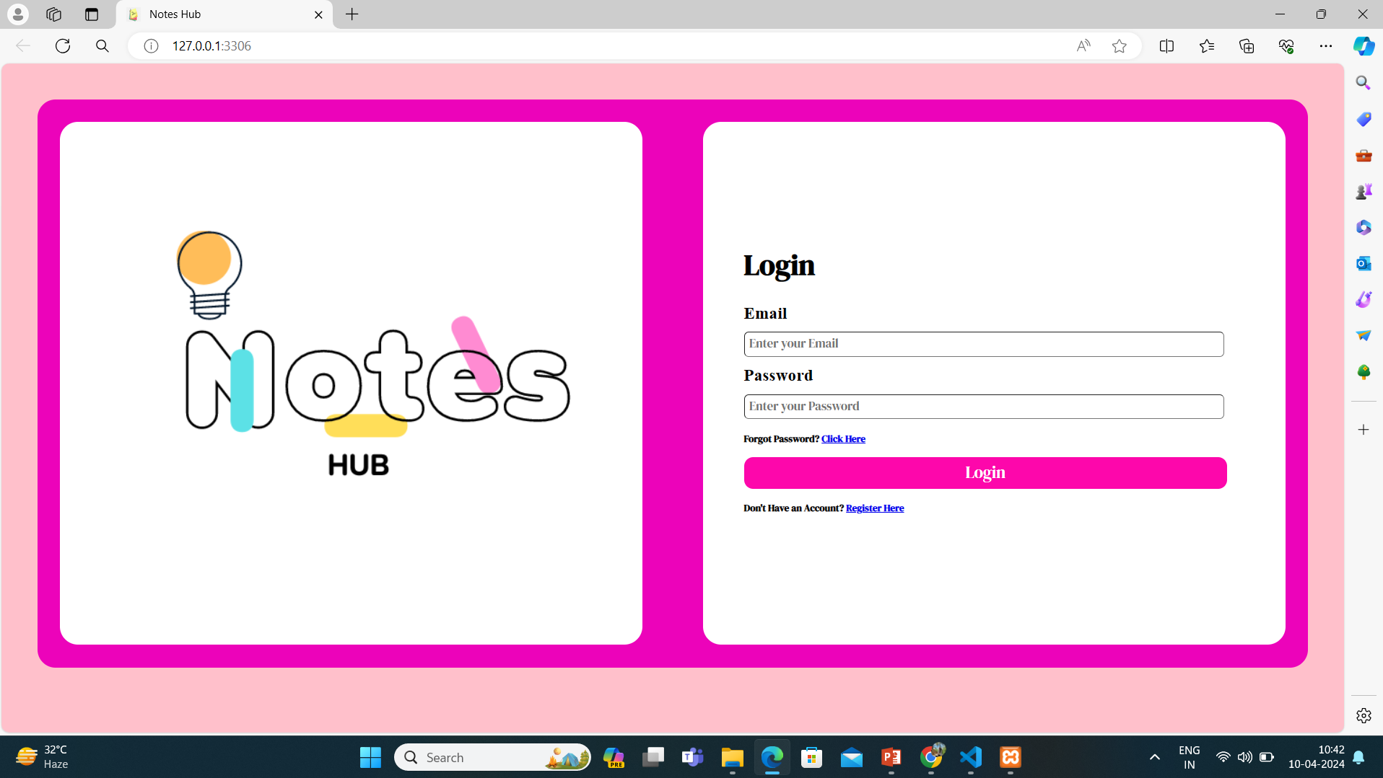
Homepage

Slide 10
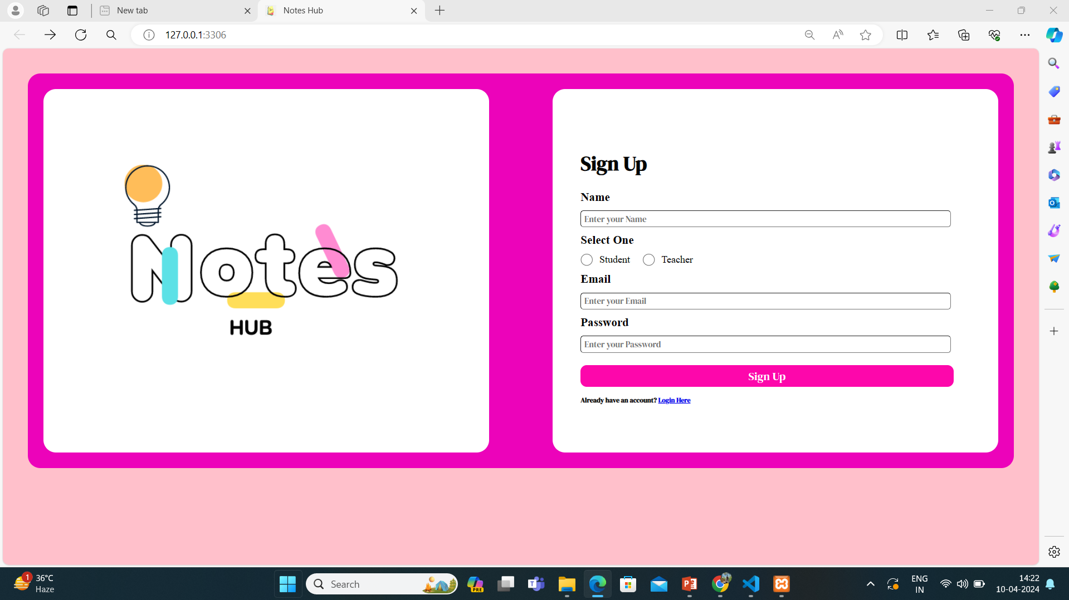
Sign up page

Slide 11
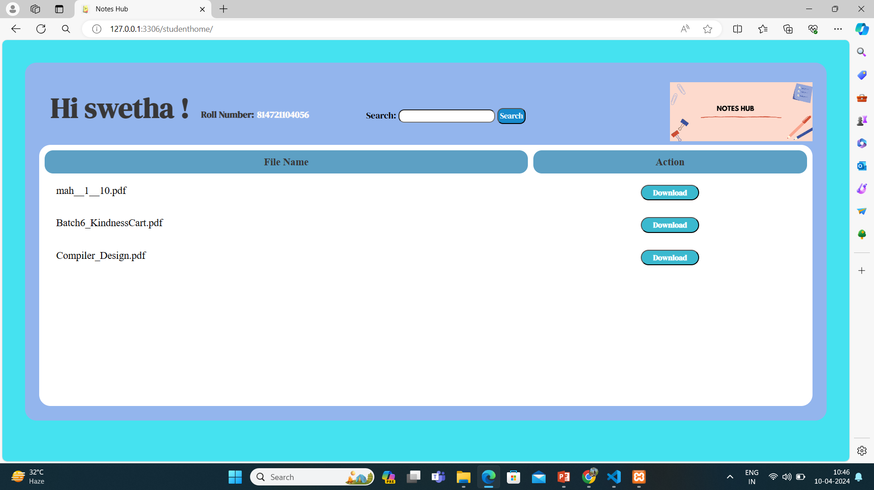
Student home page

Slide 12
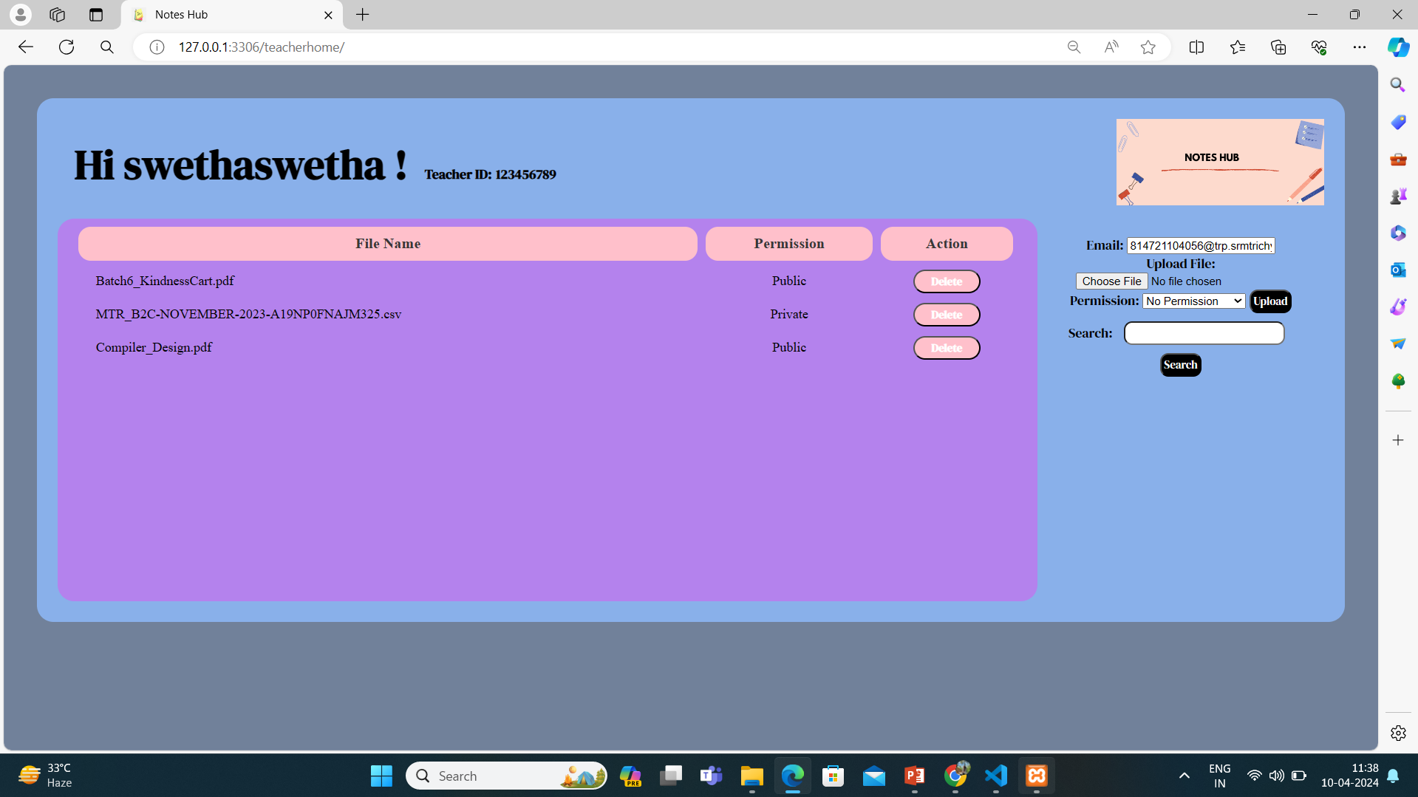
Teachers home page

Slide 13
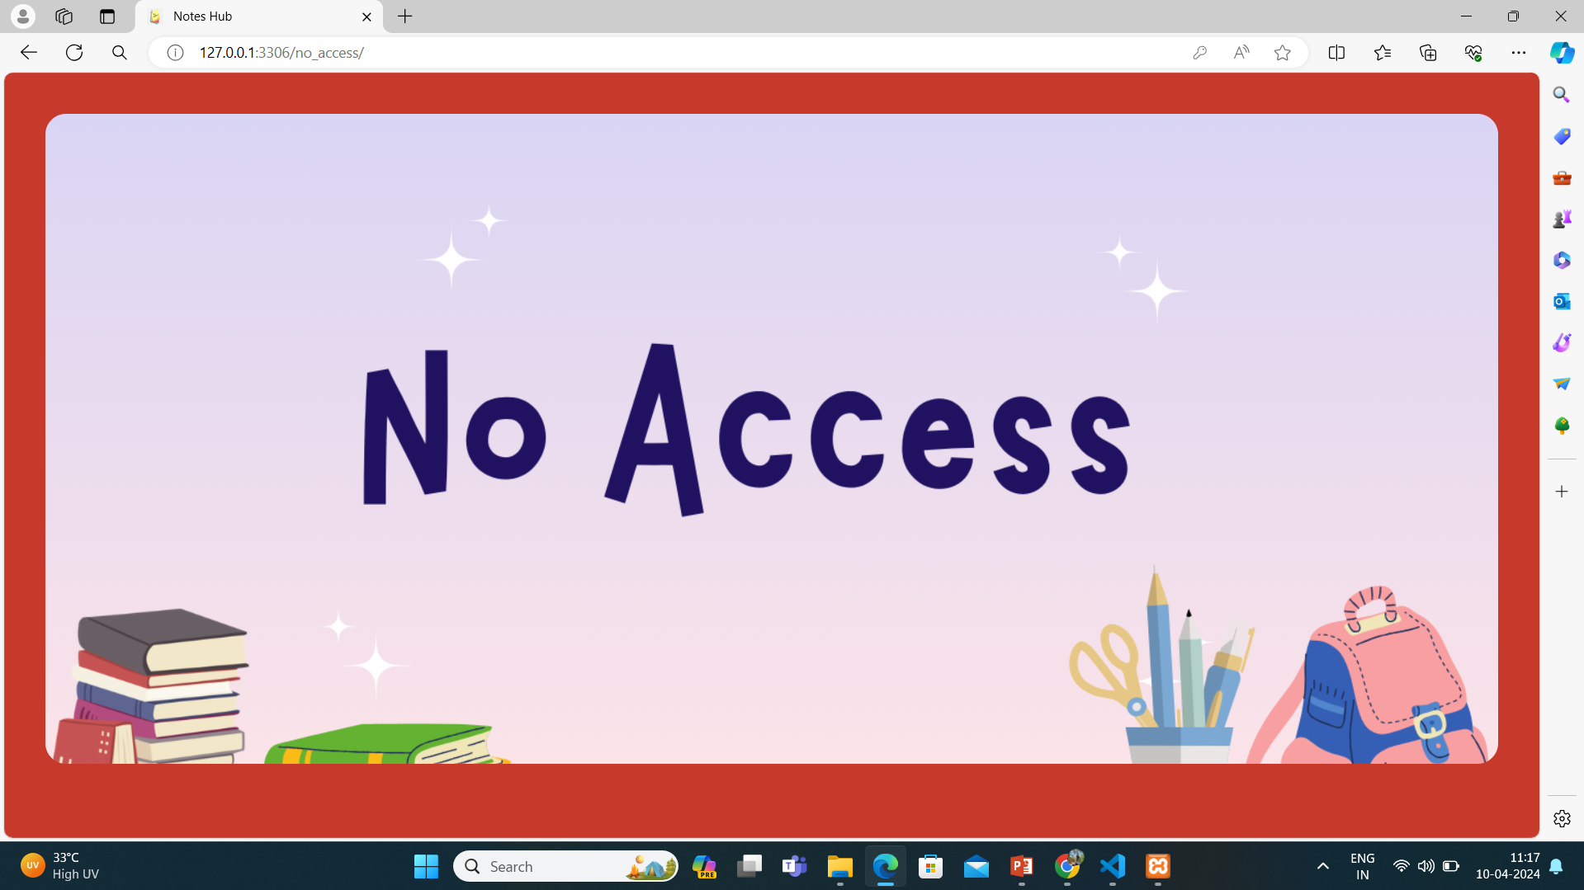
No Access page

Slide 14
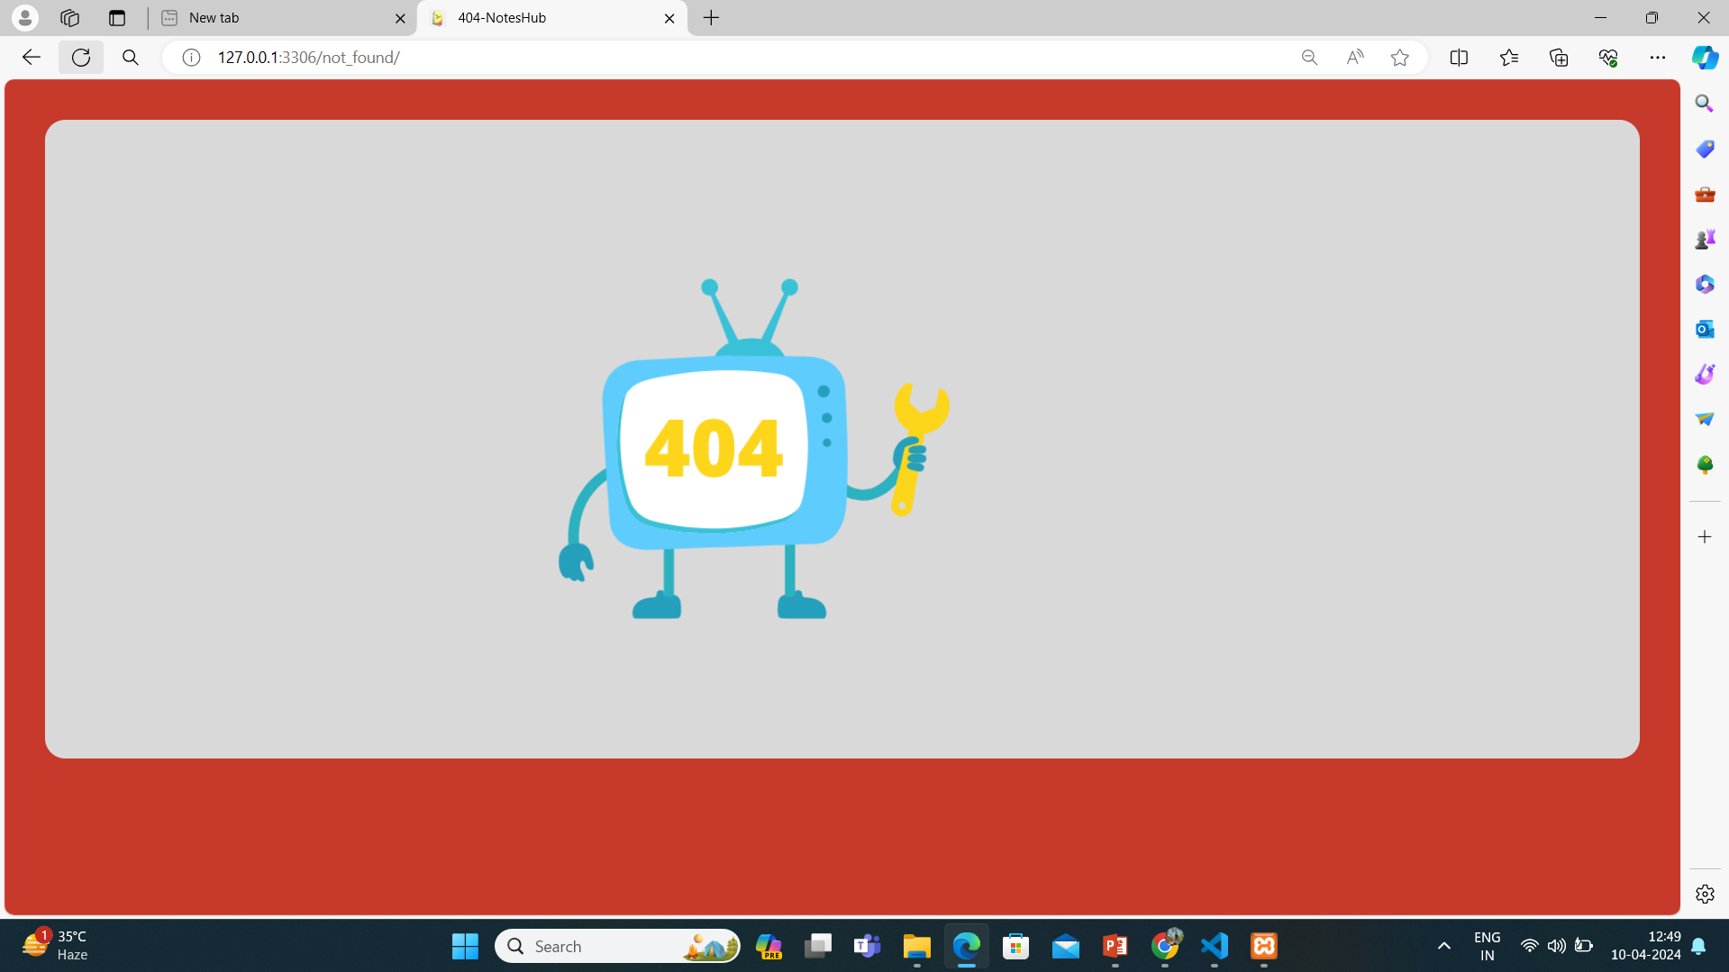
404 error

Slide 15
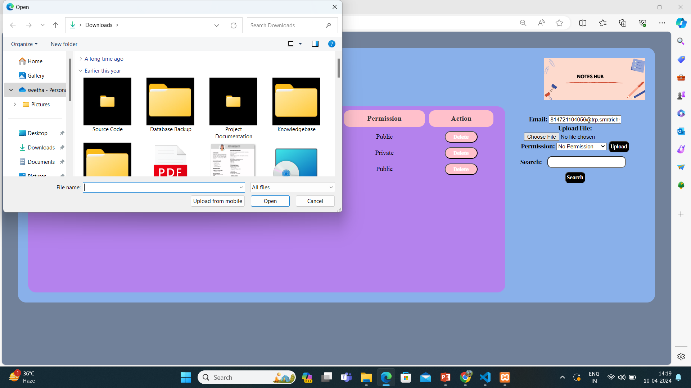
Students upload page

Slide 16
Future Enhancements:
To enhance my notes sharing application,
1.implementing collaborative editing for real-time group work,
2.version history for tracking changes,
3.advanced search filters for efficient note retrieval.
I can Provide offline access and ensure data security through encryption and two-factor authentication.
Integrate with productivity tools, offer customizable templates, and optimize for mobile devices.
We can Incorporate analytics for user insights and feedback tools for collaboration.
based on user feedback and market trends to improve the overall user experience and productivity.

Slide 17
Conclusion
In today's interconnected world, effective note sharing is pivotal for seamless collaboration and productivity.
Our notes sharing application, with its robust features and user-centric design, aims to revolutionize how teams and individuals organize, share, and collaborate on information. From real-time collaborative editing to advanced search capabilities and mobile optimization, we strive to provide a comprehensive solution that meets the diverse needs of modern workflows. By prioritizing security, innovation, and user feedback, we are committed to continuously enhancing our platform to empower efficient collaboration and drive success
Source :

Slide 18
Thank You!
Notes:
Thank You !!

